Slide 1

Accessible VR Puzzle Game
Notes:
Hey check out this torus theme

Slide 2
Core Concept
Puzzle Boxes fall out of a chute onto your table
Solve them and throw them into a completion zone.
Contents are put together to form an assembly
Notes:
Details? We’re making boxes that the player opens in order to get parts for a thing they’re assembling. I don’t know what the thing is, but hopefully they’ll stay interested.

Slide 3
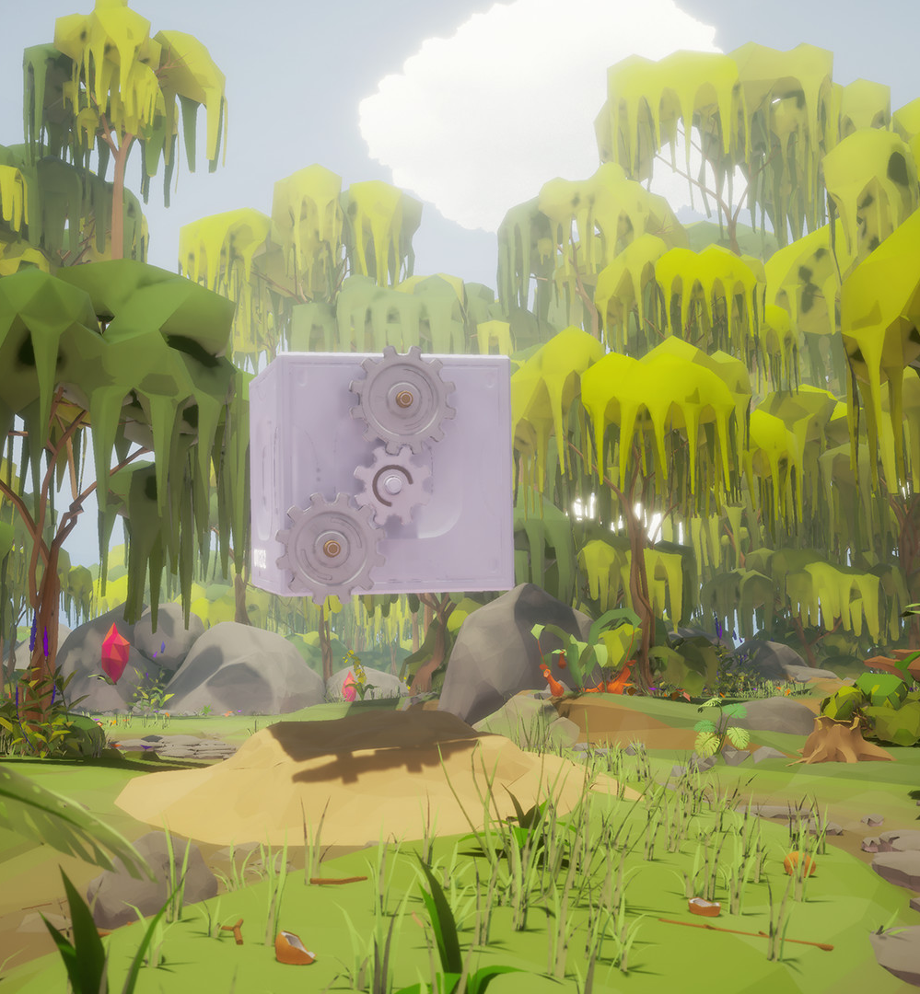
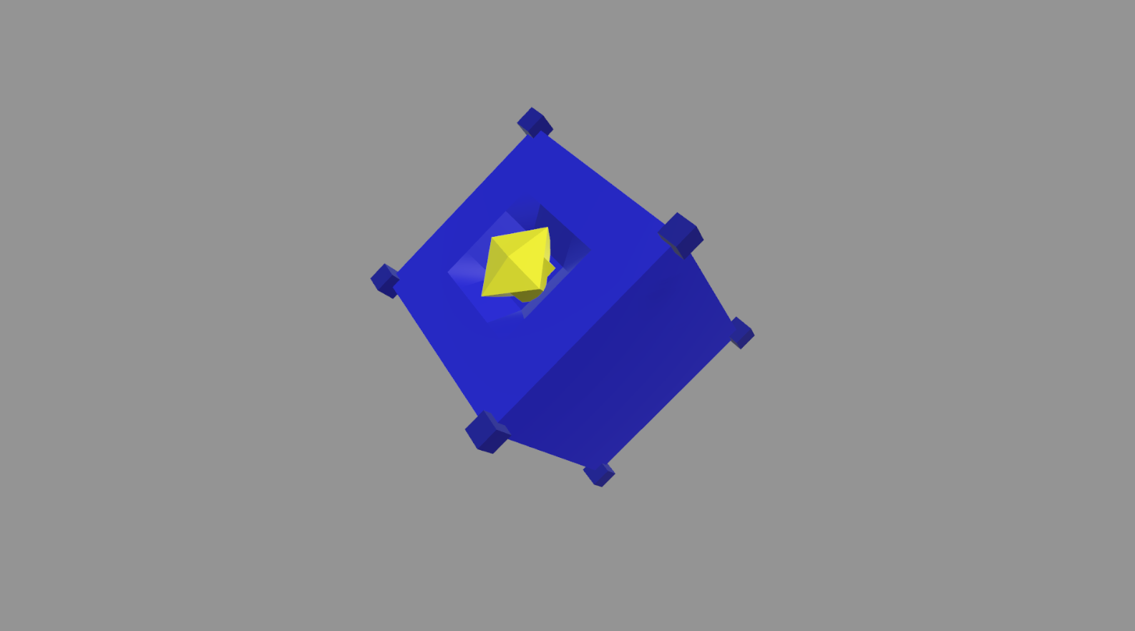
Level Design
First “level” is almost a tutorial.
Second up is a 3d marble maze.
Third is a mechanical cogs puzzle.
We’ll see about having time for more.
Screenshot from Dreamo steam store page
Notes:
First is button on bottom of box
Second mention the maze wraps around the edges, guide ball to a space.
Third is the cog puzzle, like from Dreamo

Slide 4
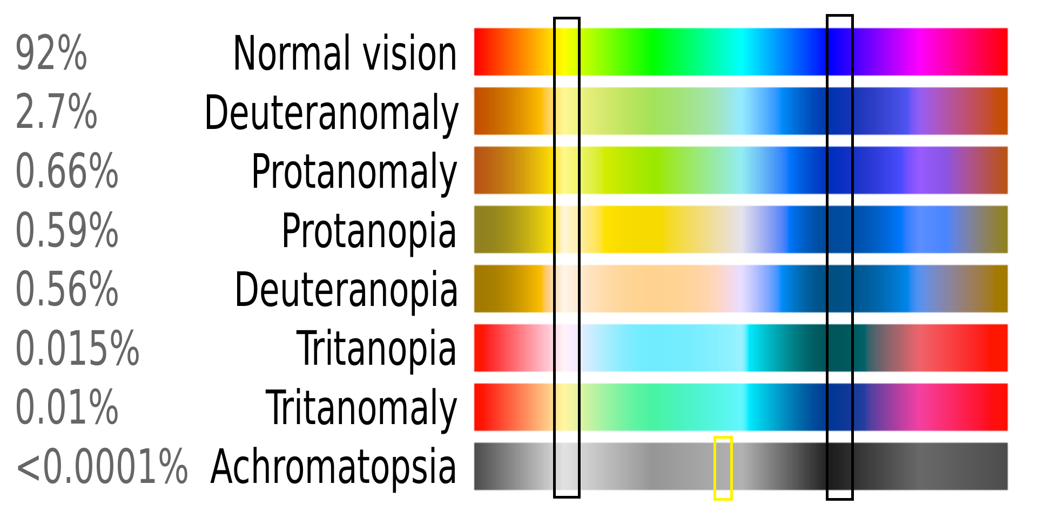
Accessibility Options
Notes:
So, the grey colour (in yellow on the bottom) is the sort of metallic surface for most of the background elements, the right band (blues) are objects that can be picked up, and the left band (yellow on normal) is interactable parts. These bands are complimentary and distinct on all vision types, but we can also give the player a slider to adjust them for personal preference.

